Slide 1
Image Compression

Slide 2
Image Compression
Compression means to reduce
Image compression is the method of data compression on digital images.
Image compression is an application of data compression that encodes the original image with few bits. The objective of image compression is to reduce the redundancy of the image and to store or transmit data in an efficient form.
Why Image compression is necessary:
Store data in an efficient form
Transmit data in an efficient way
Website can take longer to load, and can cause visitors to bounce because of this.
Uploading an uncompressed image can take a while, and some email servers have a file size limit.
For reducing the storage impact on your hard drive

Slide 3
Image Compression
Types of compression:
Lossless Compression/Irreversible Compression
RAW- Original optical data captured by camera sensors
PNG- Portable Network Graphics
BMP- Bitmap File
Lossy Compression/Reversible Compression
JPEG- Joint Photographic Expert Group
GIF- Graphics Interchange Format

Slide 4
Image Compression
JPG: Also known as JPEG, this format gets rid of bits. A normal amount of compression will not be noticeable, while extreme compression may be obvious.
If you rotate the JPG too much, you'll notice a difference in quality. This is because the photo has to recompress itself with every rotation, losing some data in the process. There are however programs out there that rotate a JPG losslessly. The same degradation applies if you save a JPG multiple times.
GIF: Compresses files by reducing the number of colors it has. If the photo has more than 256 colors (the maximum amount of colors older computers could have) this format will make the image look less appealing. The best use for GIFs are for images that are animated.
The example below shows a comparison between GIF images which range from 8 colors to 256 colors.

Slide 5
Image Compression
RAW - Found in many DSLRs, and keeps all the light data received from the camera's sensor. However, these files types tend to be quite large in size. Additionally, there are different versions of RAW, and you may need certain software to edit the files.
PNG - Compresses images to keep their small size by looking for patterns on a photo, and compressing them together. The compression is reversible, so once you open a PNG file, the image recovers exactly.
BMP - A format found exclusively to Microsoft. It's lossless, but not frequently used.

Slide 6
Lossy Compression
In which some of the data from the original file is lost.
The process is irreversible, once you convert to lossy, you can't go back.
The more you compress it, the more degradation occurs.
JPEGs and GIFs are both lossy image formats.
By default WordPress uses a lossy compression rate of 90% to optimize JPEG images when creating preview images.
Significantly reduced file size, but it also means there is quality loss.
Percentage of compression can be controlled manually
Percentage of compression means the reduction of size
Higher degree of compression the higher loss of quality

Slide 7
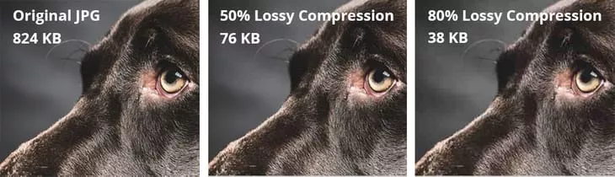
Lossy Compression
Look at lossy compression below
Compression artifacts can be visible with rate of compression is increased
With 50% compression applied we decreased our image file size by 90%.
With 80% compression applied we decreased our image file size by 95%.

Slide 8
Lossy Compression
Lossy advantages and disadvantages
Advantages: Very small file sizes and lots of tools, plugins, and software support it.
Disadvantages: Quality degrades with higher ratio of compression. Can't get original back after compressing

Slide 9
Lossless Compression
Lossless compression refers to compression in which the image is reduced without any quality loss.
This is done by removing unnecessary metadata from original image
The big benefit to lossless compression is that you can retain the quality of your image and still achieve a smaller file size.
We took the same image again and ran it through our Optimus Image Optimizer plugin, which uses lossless compression.
It can be converted into original image again.
Manually compression percentage can’t be controlled
Only few portion is compressed

Slide 10
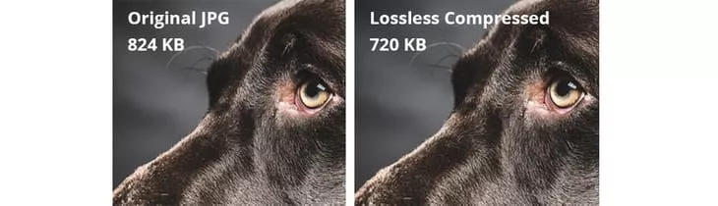
Lossless Compression
Example of lossless compression
There is almost no noticeable difference.
File size decreased by 14%. So if you are looking to retain the quality of your images, lossless compression is definitely the way to go.

Slide 11
Lossless Compression
Advantages: No loss of quality, slight decreases in image file sizes.
Disadvantages: Larger files than if you were to use lossy compression.

Slide 12
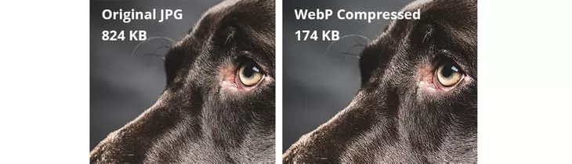
WebP Lossless Compression
A special compression technique of Google
It reduces image size like lossy compression but preserves quality like lossless compression
The file size decreased by 79%.
All application doesn’t support, Only supported browsers can use this compression technique
Advantages: No loss of quality, large decreases in file size.
Disadvantages: Less browser support, slightly larger file sizes than lossy

Slide 13
Image Compression: How they work
Deflate
Deflate is a lossless data compression algorithm used for PNG images.
It uses a combination of LZ77 and Huffman coding to achieve compression results that do not affect the quality of the image.
Run-length
Run-length encoding takes redundant strings or runs of data and stores them as one unit.
Suppose there are 12 white pixels and 12 red pixels. Normally, it is written as WWWWWWWWWWWWRRRRRRRRRRRR, with W representing the white pixel and R the red pixel. Run length would put the data as 12W and 12R.
Transform
Transform encoding is a lossy compression commonly used for JPEGs. There are millions of shades of colors, and transform encoding takes colors that have similar shades and makes them one single value. Depending upon the compression value you define (i.e. the number of shades of colors you group together) you may or may not notice a difference in the image's quality.

Slide 14
JPEG/JPG Compression
Type of compression to reduce the size of the file without damaging its quality
Convert the R, G, B color format to Y, Cb, Cr format.
Some colors are more sensitive to human eyes and thus are high-frequency colors.
Reduce the size of pixels in downsampling.
Divide our image into 8*8 pixels and perform forward DCT(Direct Cosine Transformation).
Then we perform quantization using quantum tables and we compress our data using various encoding methods like run-length encoding and Huffman encoding.
In the second stage, we decompress our data
We decode our data, and we again de-quantize our data by referring to the quantization table.
Then we perform Inverse DCT and upsampling to convert it into original pixels and finally, color transformation takes place to convert the image into its original color format.

Slide 15
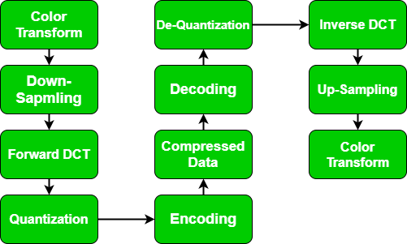
JPEG/JPG Compression

Slide 16
JPEG/JPG Compression
Algorithm of JPEG Data Compression :
Splitting – We split our image in the blocks of 8*8 blocks. It form 64 blocks in which each block is referred to as 1 pixel.
Color Space Transform – In this phase, we convert R, G, B to Y, Cb, Cr model. Here Y is for brightness, Cb is color blueness and Cr stands for Color redness. We transform it in chromium colors as these are less sensitive to human eyes thus can be removed.
Apply DCT – We apply Direct cosine transform on each block. The discrete cosine transform (DCT) represents an image as a sum of sinusoids of varying magnitudes and frequencies.
Quantization – In the Quantization process, we quantize our data using the quantization table.
Serialization – In serialization, we perform the zig-zag scanning pattern to exploit redundancy.
Vectoring – We apply DPCM (differential pulse code modeling) on DC elements. DC elements are used to define the strength of colors.
Encoding – In the last stage, we apply encoding either run-length encoding or Huffman encoding. The main aim is to convert the image into text and by applying any encoding we convert it into binary form (0, 1) to compress the data.

Slide 17
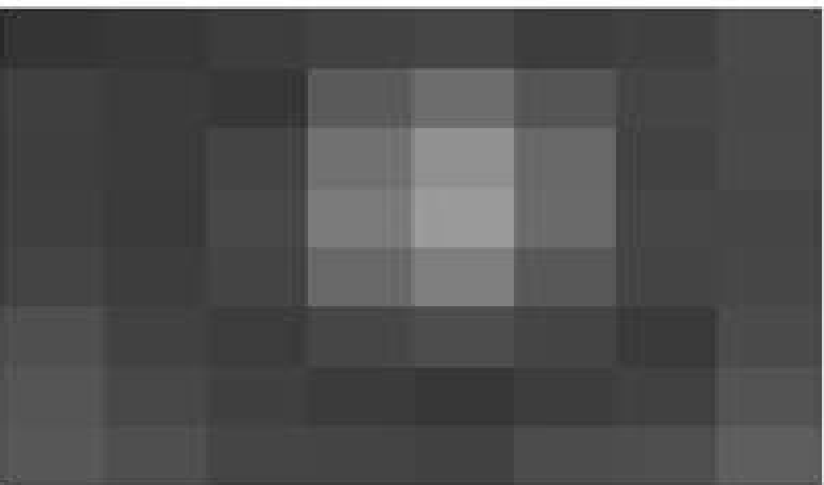
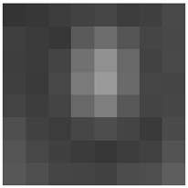
JPEG/JPG Compression: An Example
First step is to divide an image into blocks with each having dimensions of 8 x8.

Slide 18
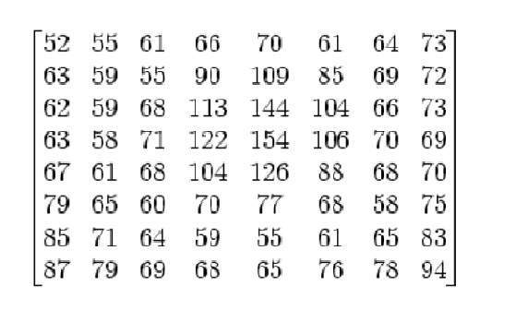
JPEG/JPG Compression: An Example
Let’s consider that this 8x8 image contains the following values.

Slide 19
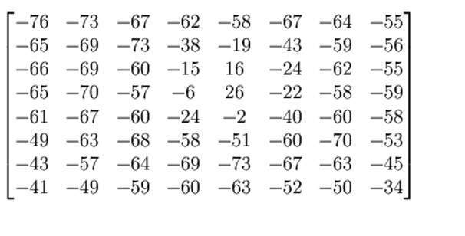
JPEG/JPG Compression: An Example
The intensity values ranges from 0 to 255. and needed to convert in the range from -128 to 127.
Subtracting 128 from each pixel value yields pixel value from -128 to 127. After subtracting 128 from each of the pixel value, we got the following results.

Slide 20
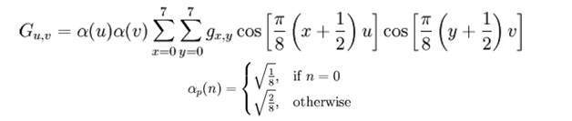
JPEG/JPG Compression: An Example
Convert the values with DCT (Discrete Cosine Transformation) using the following equation
The result comes from this is stored in say A(j,k) matrix.

Slide 21
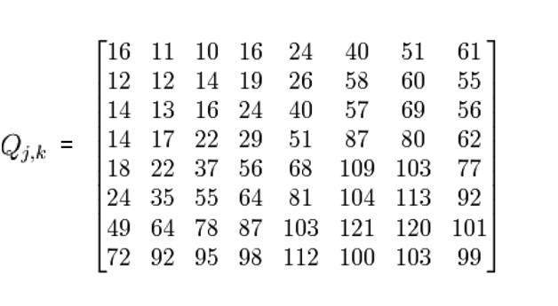
JPEG/JPG Compression: An Example
A standard matrix that is used for computing JPEG compression, which is given by a matrix called as Luminance matrix is given below

Slide 22
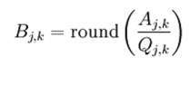
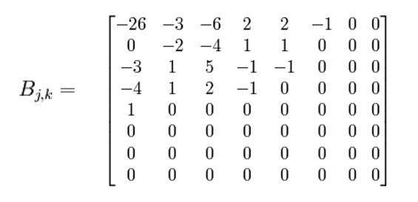
JPEG/JPG Compression: An Example
Find the quantized matrix using the following
The result matrix is found as

Slide 23
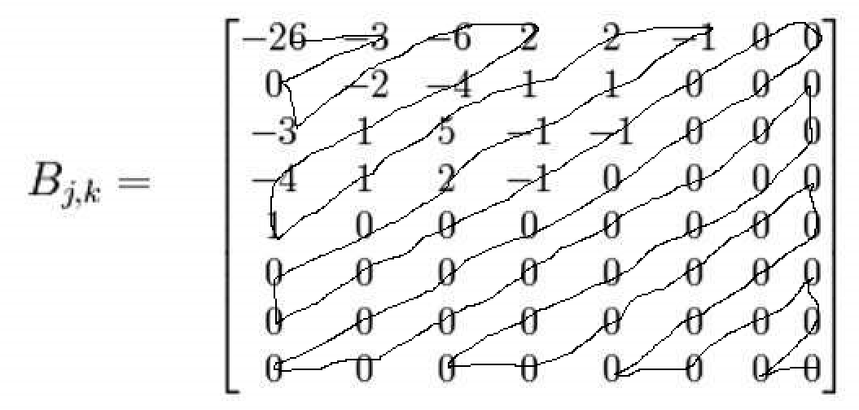
JPEG/JPG Compression: An Example
Perform the real trick which is done in JPEG compression which is ZIG-ZAG movement.
The zig zag sequence for the above matrix is shown below. You have to perform zig zag until you find all zeroes ahead. Hence our image is now compressed.
The continuous zeros at the tail can be easily removed to reduce the size

Slide 24
JPEG/JPG Compression: An Example
After zig-zag traversal data obtained as -26, -3, -6, 2, 2, -1, 0, 0, 0, -2, -4, 1, 1, 0, 0, 0, -3, 1, 5, -1, -1, 0, 0, 0, -4, 1, 2, -1, 0, 0, 0, 0, 1, 0, 0, 0, 0, 0, 0, 0, 0, 0, 0, 0, 0, 0, 0, 0, 0, 0, 0, 0, 0, 0, 0, 0, 0, 0, 0, 0, 0, 0, 0, 0
By using any encoding the tailing zeros can be eliminated
For example using RLE it generates ……….31, 0
This portion can be deleted and size is reduced

